Slide 1

GIT Patterns and Anti-Patterns
Name – Sohil Shah
SID – N606131

Slide 2

Background
Masters in Computer Science from Rochester Institute of Technology, New York
TAP 2015
Corporate Quick Pay AD Team (CQP TechEx)
>40 developers with 5 Scrum and 1 Kanban team
We are Scaled across teams and regions.
Notes:
How many Software Engineers do we have?
Who has or is using GIT?
Issues with Merge/Rebase?

Slide 3
Things to cover
What is GIT?
Branching Strategy
Merge vs Rebase
DB Branching
Toggle Switches
GIT commands

Slide 4
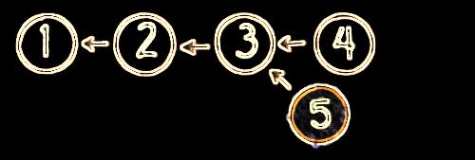
What is GIT?
Most widely used modern version control system.
Immutable commits
Open Source
Designed for a distributed environment
Better performance
Better Security
Better Flexibility
Very powerful

Slide 5
Branching Strategies
Sprint
Trunk
Feature
Story

Slide 6
Branching Strategies
SPRINT/TRUNK
Rapid deployments. Almost every Sprint.
Code Integration is round the clock. Overhead of Merging/Rebasing is eliminated.
Refactoring is easy.
Works great if a stable and proven CI/CD environment exists.
Are you providing ‘Business Value’ every sprint?
Inflexible with changing product owner demands.
Peer reviews are difficult.
Experiments/POC is extremely painful.

Slide 7
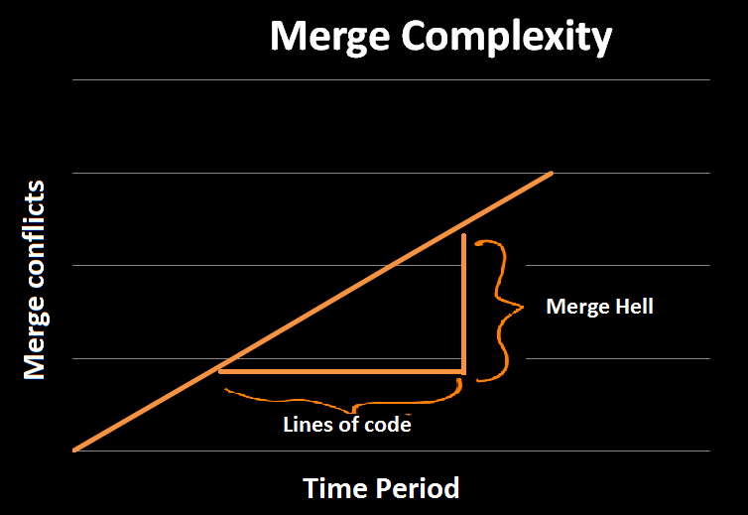
Branching Strategies
FEATURE
Each release provides business value.
Context switching.
Flexible with Product Owner demands.
Experiments can be performed.
Long lived/Stale branches leading to overhead with Merging.
Peer reviews are very difficult.

Slide 8
Branching Strategies
STORY
Individual branch for each story.
Releases can be planned on demand.
Peer reviews are performed at story level and allows better code quality.
Product Owner demands can be met effectively and can move to market very quickly.
Overhead of merging and creating branches for developers.
Conflict resolution happens when story is completed.
Requires a solid CI/CD environment to control code quality and automate peer reviews.

Slide 9
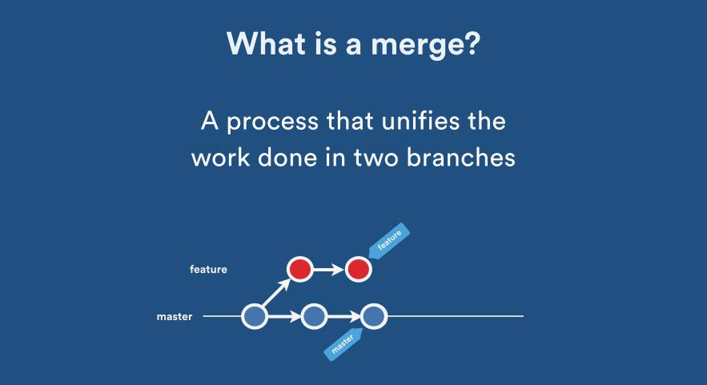

Merge or Rebase
MERGE
Creates a new merge commit.
History is clear on what is being merged into what.
Local merges can cause a lot of noise and confusion.
Resolving conflicts can become tedious.

Slide 10
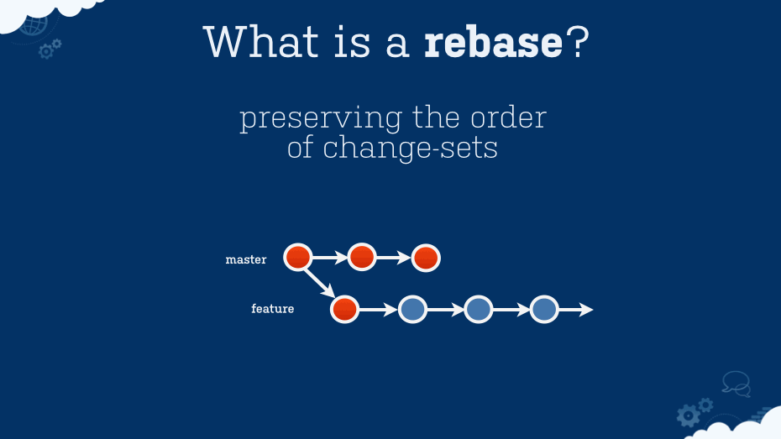
Merge or Rebase
REBASE
Takes the commits and saves it in a temporary location.
Rewinds and plays the commits on top.
No fuzzy merge commits and gives a nice linear history.
Has the interactive rebase option.

Slide 11
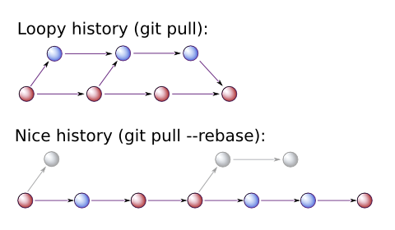
Merge or Rebase
BEST PRACTICE
Pull Requests should be done for all Peer Reviews. Keeps audits clean.
Never revert a merge commit to unmerge, use ‘git reset --hard <commitID>’ instead.
Rebase on ‘git pull’.
git config --global branch.autosetuprebase always
This prevents local merges and helps keep history linear and clean.
Never rebase a public branch.
Rebase works well with limited no. of developers working on a branch and short lived branches. It is a slow process if you have a lot of commit activity on the branch.
Decision is based on what you want others to see in the history so that it makes sense.

Slide 12
DB Branching
Everything should be version controlled.
Highly recommended for applications with heavy stored procedures.
Tools like Flyway and Liquibase provide better support.

Slide 13
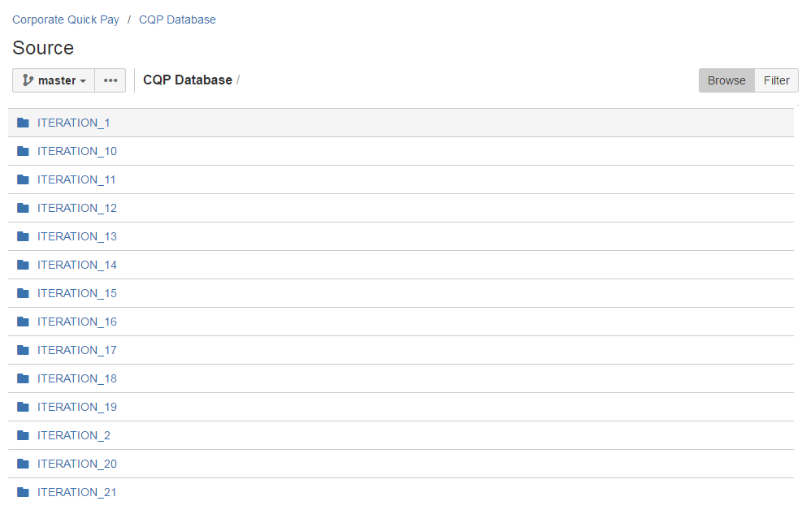
DB Branching
THE PROBLEM

Slide 14
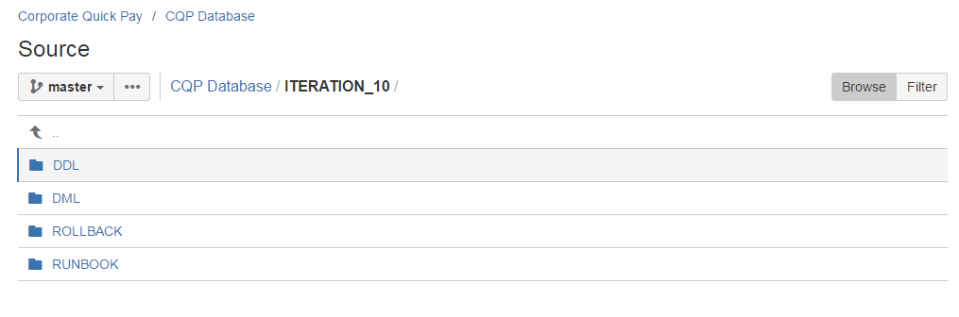
DB Branching
THE PROBLEM

Slide 15
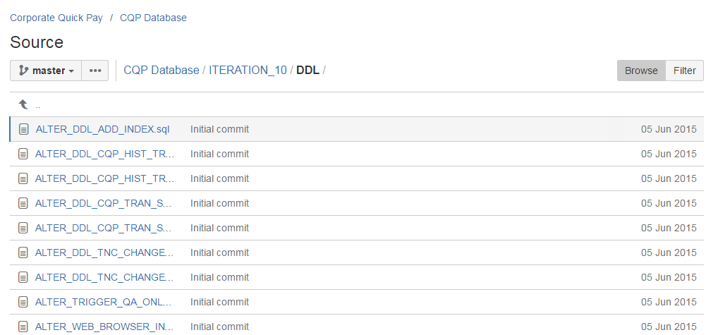
DB Branching
THE PROBLEM

Slide 16
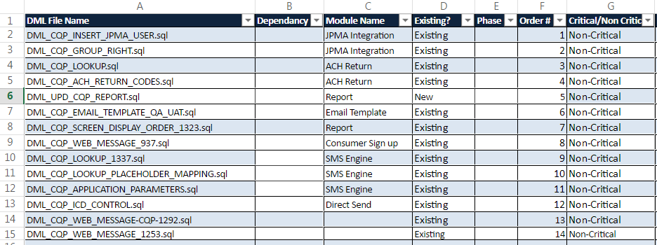
DB Branching
THE PROBLEM

Slide 17
DB Branching
The Problem
No tracking on what lies in Production.
Continuously overwriting changes with single database instance available.
Hard to have multiple developers work on same Stored Proc.
Very Difficult to audit.
Runbook management takes days to track changes and hunt developers to update it.

Slide 18
DB Branching
DIRECTORY STRUCTURE
\cqp-database-branching \DDL \Alter \Indexes \Others \Package \Package-Body \Sequences \Tables \Triggers \Types \Unit Tests \Views \DML \MasterScripts \ROLLBACK-DDL \Alter \Indexes \Others \Package \Package-Body \Sequences \Tables \Triggers \Types \Unit Tests \Views \ROLLBACK-DML

Slide 19
DB Branching
More visibility
Runbook management is eliminated.
Clear audits and visibility in the code base.
Everyone knows what is there in production and always work on the current copy.
List of all scripts changed within that branch using a simple git command.
git diff --diff-filter=AMC --name-only origin/<prodBranch>..origin/<deployBranchName>
Release packages can be created within minutes instead of days.

Slide 20
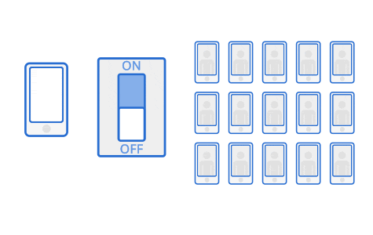
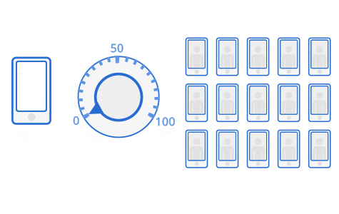
Toggle Switches
Features can be embedded within the Trunk. (Trunk based development)
Continuous Integration with ‘abstract feature branches’.
A/B testing.
Region specific testing.
Notes:
Examples…

Slide 21
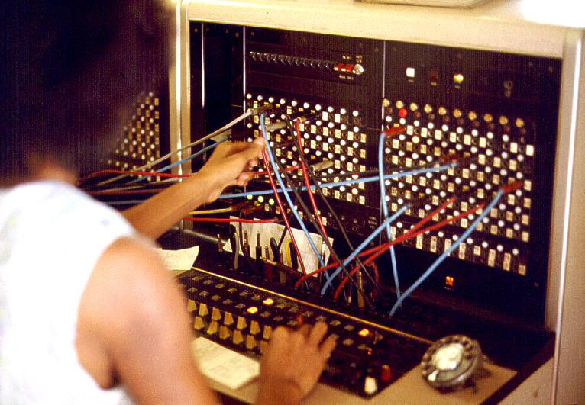
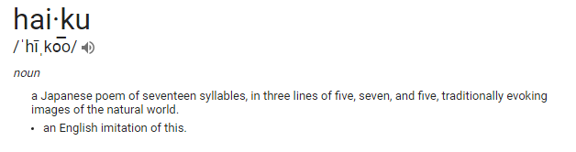
Toggle Switches
Overhead of testing with features on/off.
Technical Debt.
Database config changes to avoid Data Manipulation.
Limit the use of switches. (max 2 conditions in entire codebase)
Avoid hierarchical switches.
Haiku : Talk about switches
We have a hierarchy of them
Plug them together.
PBX Switchboard, 1975

Slide 22
Things to cover
What is GIT?
Branching Strategy
Merge vs Rebase
DB Branching
Toggle Switches
GIT Applications
GIT commands

Slide 23
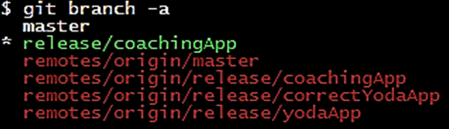
Git Commands
git branch
Find all branches in the repository,
To find what branches contains the commit,
git branch --contains <commitId>

Slide 24
Git Commands
git cherry-pick
Used to copy commits from one branch to another effortlessly without causing merge conflicts.
A merge conflict is guaranteed if there are two commits with different commit id having the same changes on the same line.
git cherry-pick <commit-id>

Slide 25
GIT Commands
git diff
Used to compare.(Branches, commits, working tree, blob, etc.)
git diff HEAD <filename>
git diff <commitID>..<commitID>
git diff <branchName>..<branchName>
git log
Used to print logs (repository, branches, files, etc.)
git log --graph
git log --all <filename>
git log --follow <filename>

Slide 26
GIT COMMANDS
cat .git/HEAD
Helps in conflict resolution when you want to know where the HEAD is pointed.
<<<<<<< HEAD
open an issue
=======
ask your question.
>>>>>>> branch-a

Slide 27
GIT COMMANDS
git ls-tree
Every commit is linked to a blob object ID tree which contains all blob Id’s for all file in the repository at that commit.
This blob id changes when the file is changed.
$ git ls-tree 48994f7c pom.xml
Output :
100644 blob b36ea3213181e26bf14338a8cf0d7dc26776b17b pom.xml

Slide 28
GIT COMMANDS
git reflog
Used to show the HEAD pointer before a command was executed
git reflog show HEAD
git reflog show –all
Output:
eff544f HEAD@{0}: commit: migrate existing content
bf871fd HEAD@{1}: commit: Add Git Reflog outline
9a4491f HEAD@{2}: checkout: moving from master to git_reflog
9a4491f HEAD@{3}: checkout: moving from Git_Config to master
39b159a HEAD@{4}: commit: expand on git context

Slide 29
Questions

